Slide 1
Visit these links and make your project like this. Mention the link of your website in your resume. This will make you different from others. Project of Kamana: http://kamanabaproject.wix.com/mmsbaproject Project of Kalyani: http://kalyaninerellaba.wix.com/mmsbaproject

Slide 2
Steps to create a website in wix.com

Slide 3
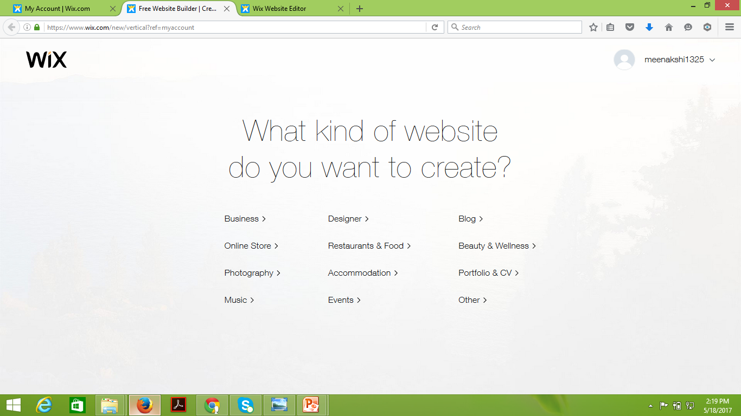
Visit website http://www.wix.com/
Sign up to create your own website.
The below given dialogue box will appear
Select your template based on your project or choice

Slide 4
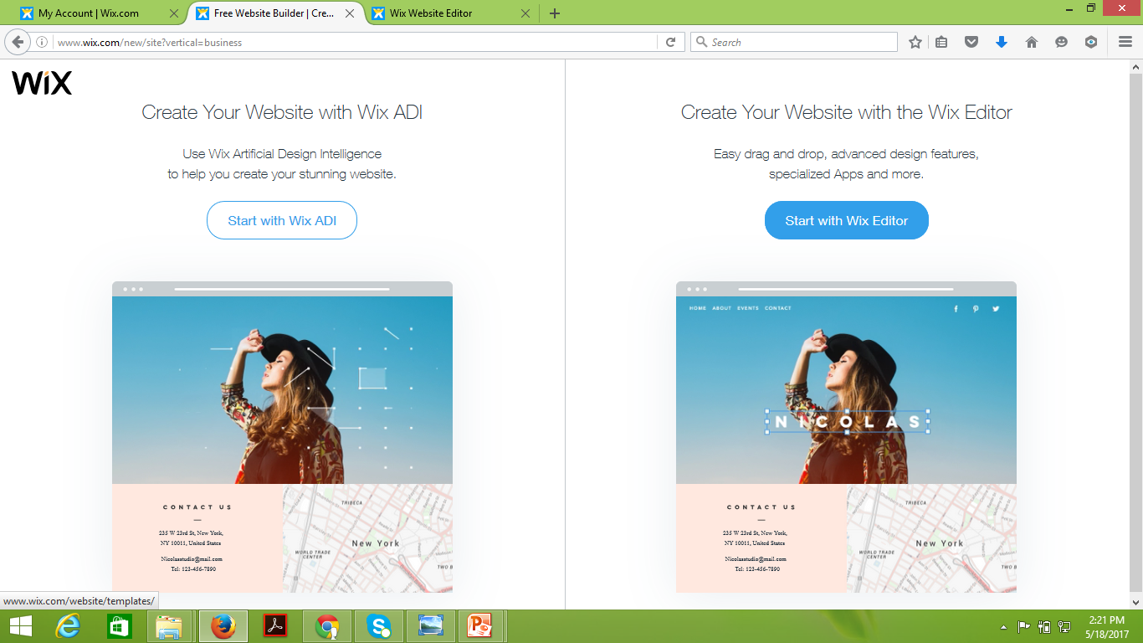
The below given page will appear once you select template.
Click here

Slide 5
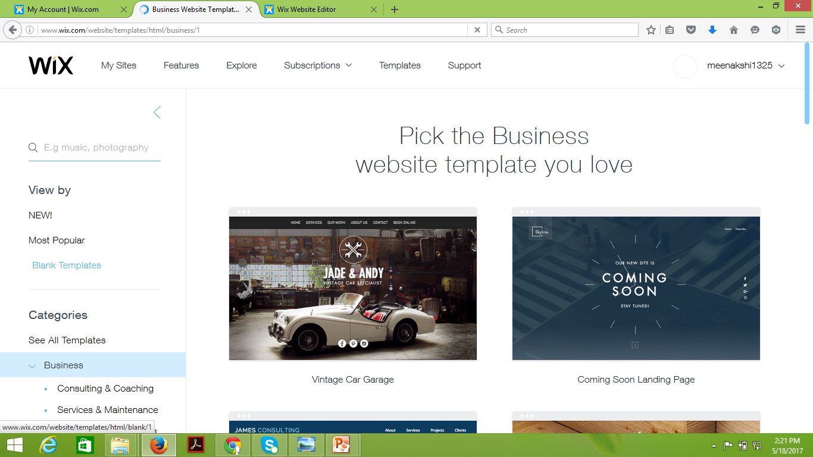
A page with different categories templates will appear.
To select theme template, click here
To select blank template, click here

Slide 6
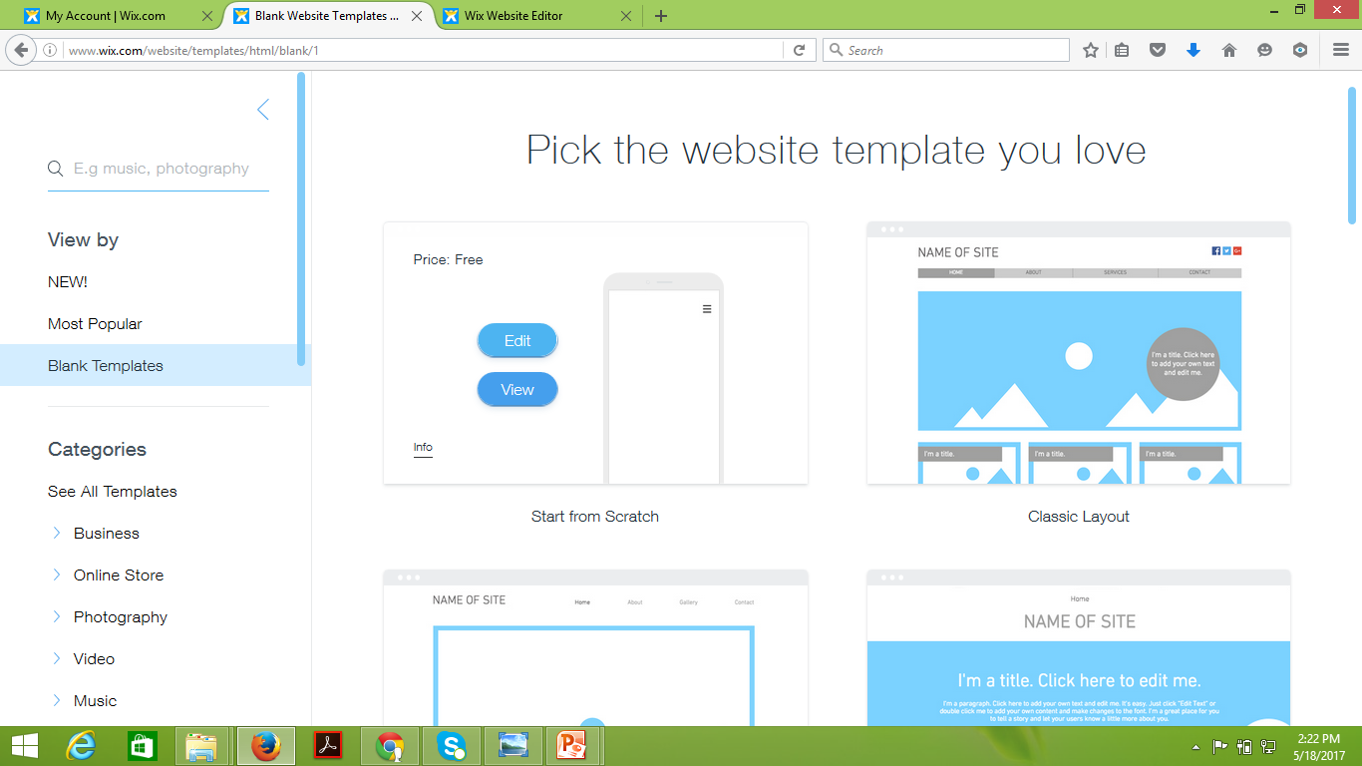
You will get a page as shown below ,click on start from scratch and edit to create your website.
Click on start from scratch and edit

Slide 7
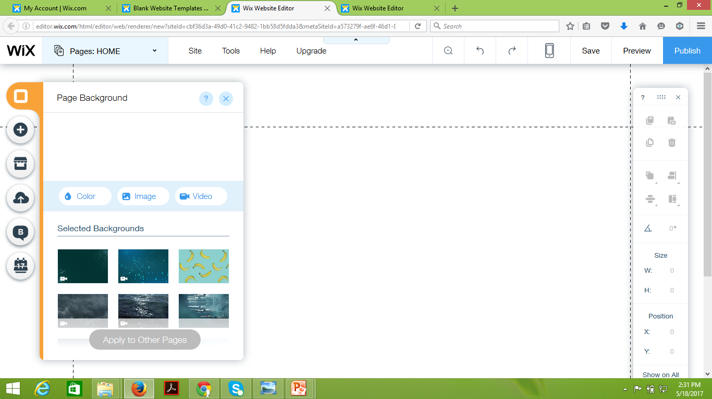
Select the page background option given on left to set background of your choice.
Select page background

Slide 8
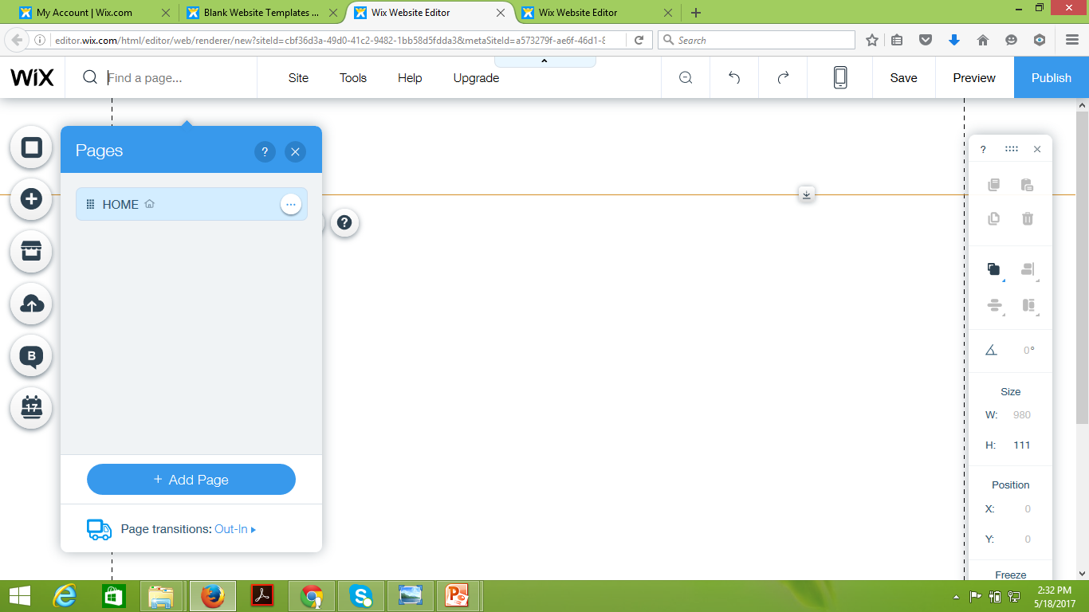
Select the Pages from HOME menu .Add pages based on your project.
Select Add page

Slide 9
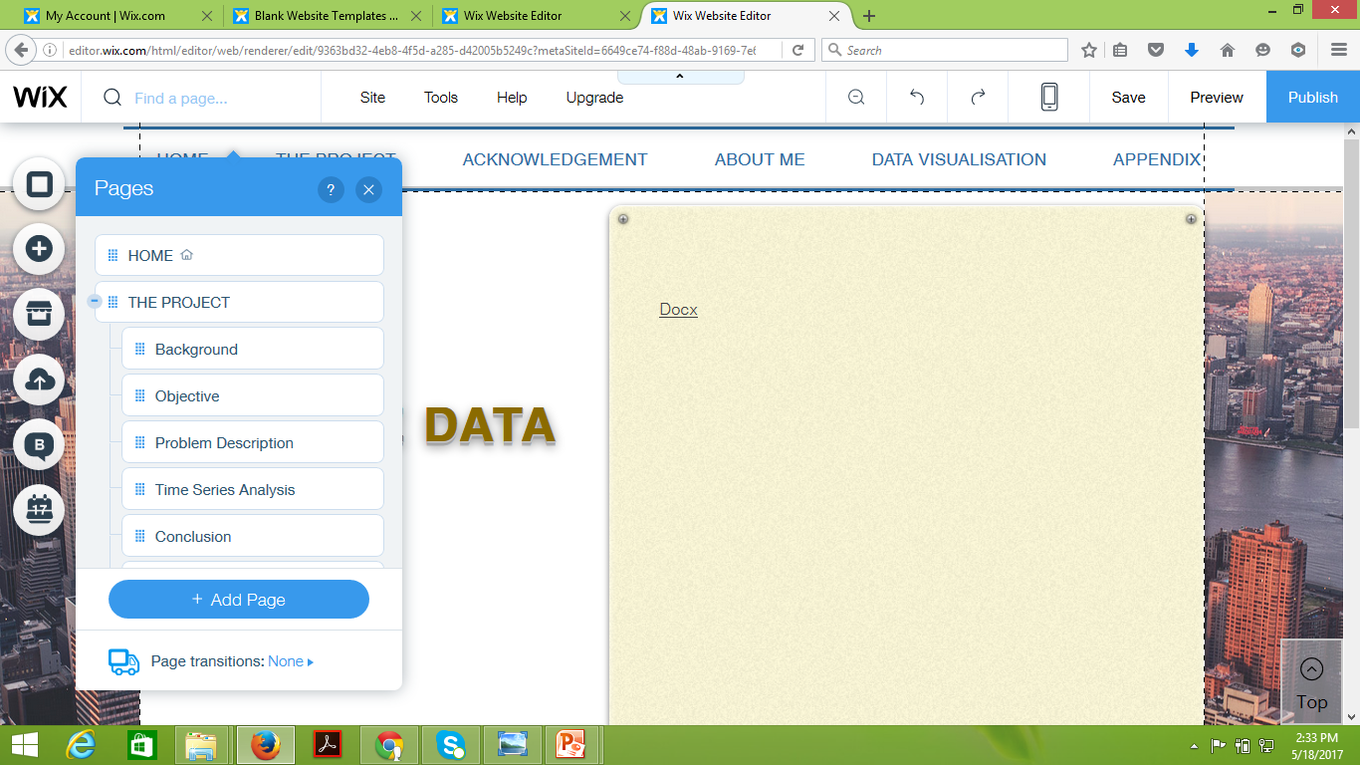
For sub-heading or sub-page you can drag the box under the headings it to the right
Headings
Subheadings

Slide 10
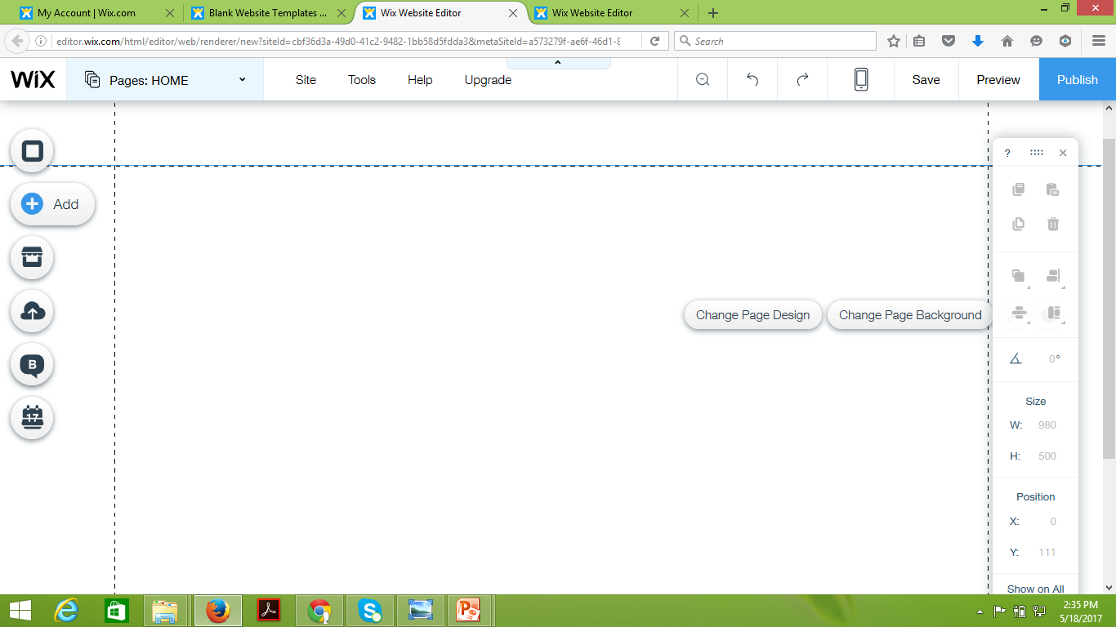
To add the text ,images ,menu,blog,video etc.. Go to add button at the left hand corner of the page
Cick here

Slide 11
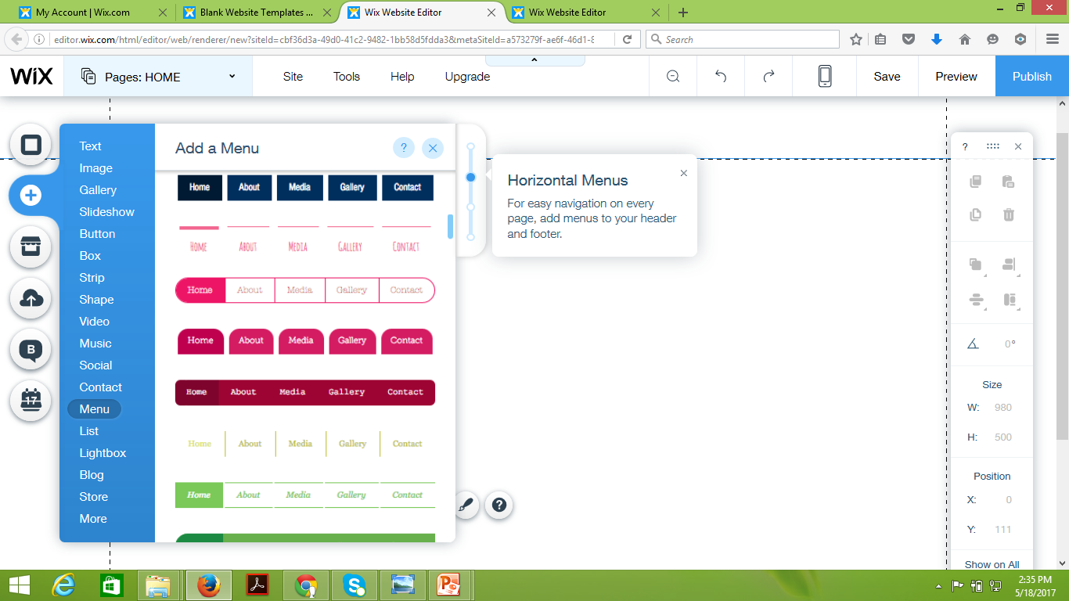
To add menu in your website .Go to menu and select design and give menu headings as required.

Slide 12
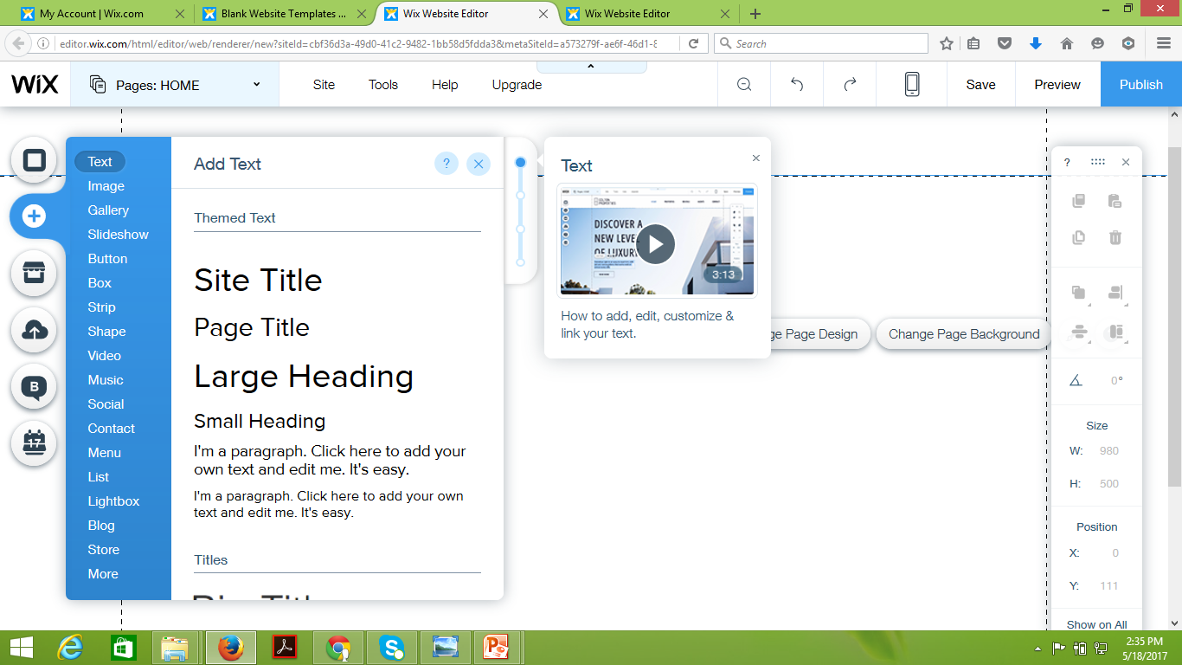
Select text and then go for page title and can write details of your project by choosing the paragraph

Slide 13
Save and preview your data after each step.
The link for your website is the URL which you will keep for saving the data.
For more details please refer to:
http://bit.ly/newwix
https://meenakshi1325.wixsite.com/exchange-rate-sip
http://kalyaninerellaba.wix.com/mmsbaproject
http://kamanabaproject.wix.com/mmsbaproject

